Slide 1
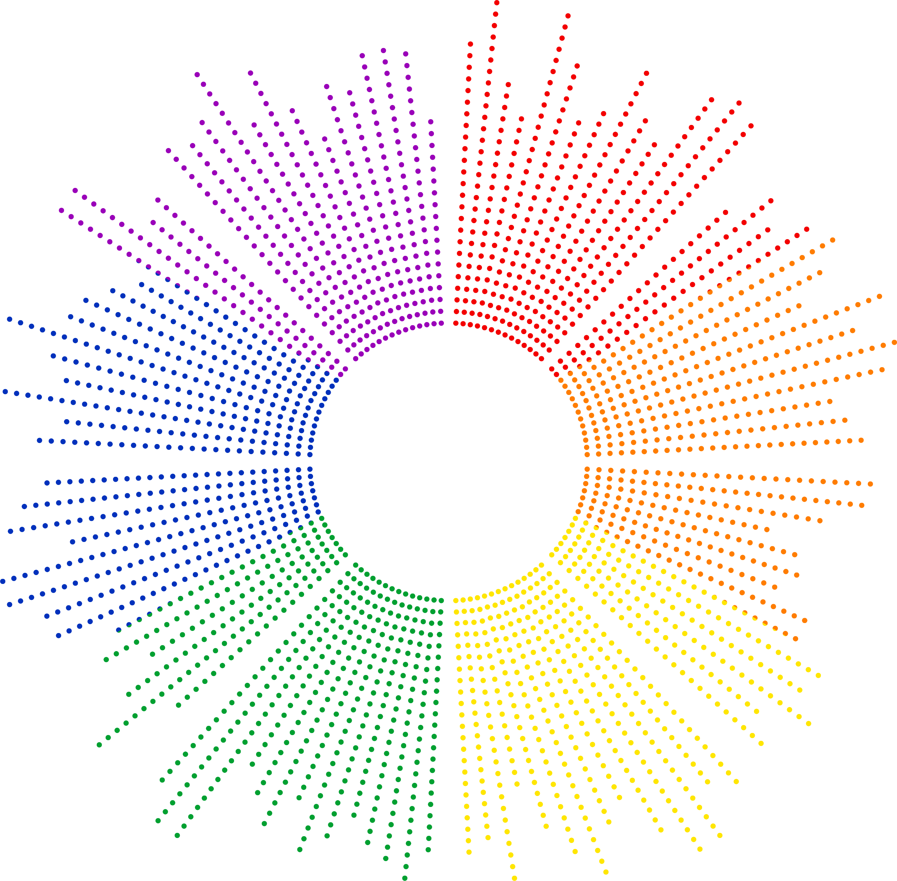


Spatial AI Lab:
Interpretation of 3D Autoregressive Transformers
Ethan Cao
10/02/2026

Slide 2
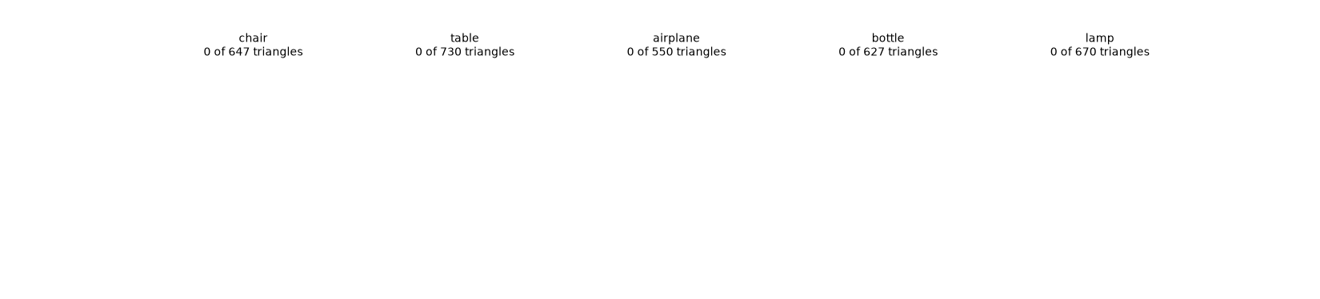
Research Proposal
What’s inside the black box?
Context: Substantial research have been made into the development of autoregressive 3D generative models, i.e. MeshGPT and followed by a series of variant and improved models.
GIF: Demonstration of autoregressively generating triangular meshes

Slide 3
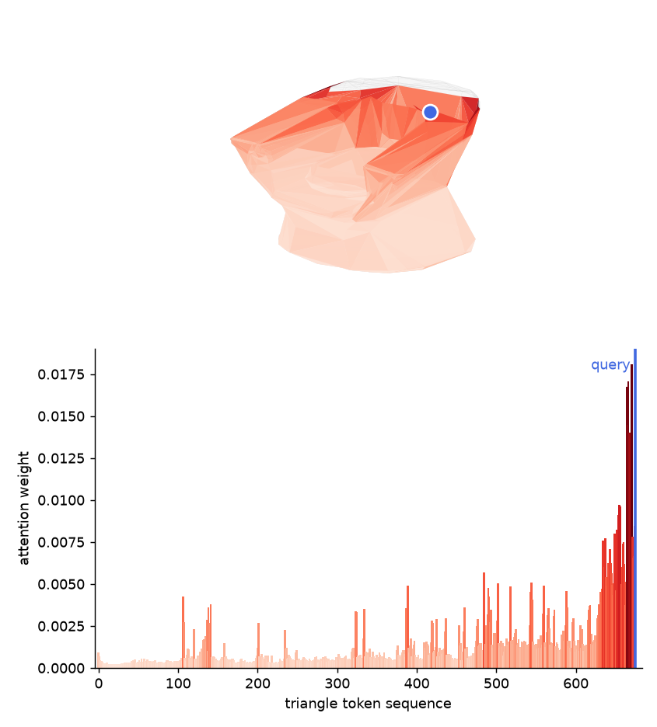
Research Proposal
How to interpret 3D Autoregressive Mesh Transformers?
The Gap:
  There is no published study of what individual attention head do in mesh generation transformers. Recent models are developed with assumptions of attention mechanisms rather than systematically and quantitatively measuring it.
Opportunity:
  In language models, measuring attention head behavior led directly to a design of faster decoding and memory caching features. DuoAttention (ICLR 2025).
  The same approach and inspiration can be applied to enhance autoregressive mesh transformers.
We examine the question of what query triangles attend to in the early token sequence, and why?

Slide 4
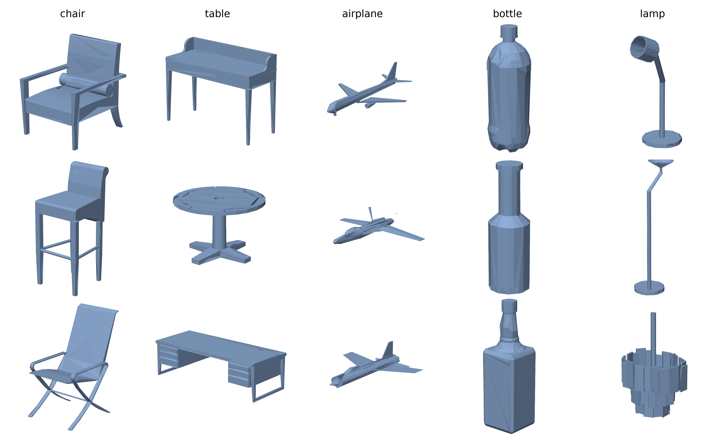
Experimental Method
Data Set & Model of Choice
Choose 500 ShapeNet shapes from 5 shape categories: chair, table, airplane, bottle, lamp
Choose 4 model families to experiment with:
  MeshGPT: learned-codebook decoder only transformer
  MeshXL: raw coordinate prediction decoder only transformer
  DeepMesh: “Point-cloud to mesh” generators with hourglass transformer structure
  MeshMosaic: “Part by part” mesh generators, generates in small patches and fuses together into one mesh object
5 categories of shape examined

Slide 5
Experimental Method
Feed: run inference by passing 500 ShapeNet meshes into each model in one forward pass
Record: at one query triangle, save the attention weight each head gives to every earlier triangle
Select: select attended triangles that holds significant attention weight assigned by a head.
Group: group ShapeNet triangles into clusters by different their triangle properties
Compare: for each head, compare what category (cluster) of triangles do the attended triangles fall into.
Potentially find generalizable patterns across the 4 models
Model Enhancements：
Hard code attention head with rules/policies
Etc…

Slide 6
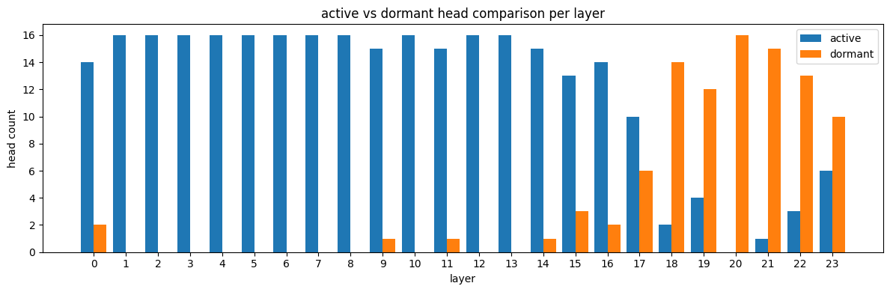
Experimental Method
Examining “active” attention heads
Active-Dormant head classification:
  Dormant heads attend largely to the “beginning of sequence” token or to the very first few tokens of the token sequence.
  Active heads pay attention to nearby tokens, or any tokens that are not the BOS or initial tokens.
MeshGPT: most attention heads become ‘active’ at earlier layers and become ‘dormant’ at later layers.
We examine ‘active’ heads as they present more informative insights by attending to a variety of tokens / triangles

Slide 7
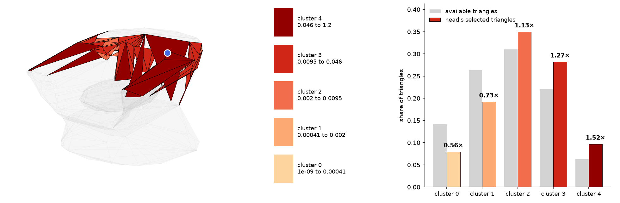
Experimental Method
What ‘kind’ of triangles do the heads attend to?
Selection of triangles for examination:
  Cluster the 500 chosen shapes by their triangular mesh features: Aspect Ratio, Area, X-axis, Y-axis, and Z-axis normal vector orientation into 5 clusters for each property.
  Compare which of clusters do the attended triangles fall into.
Query triangle
All triangles in the token sequence
Attended Triangles by the currently selected attention head
5 Area clusters, from smallest area to largest area
Area Clusters

Slide 8
Current Findings (WIP)
TLDR
Across the four models, individual attention heads show tendencies to prefer specific shapes of triangles. (differing by the model, head, and transformer layer)
I.e. certain heads strongly favor large area triangles and some other favor thin and elongated shaped triangles.
These shape preferences have been shown to be consistent at different query positions across the entire generated mesh token sequence.
These behaviors are inconsistent across different transformer layers (we classify into early, middle, and late layers)

Slide 9
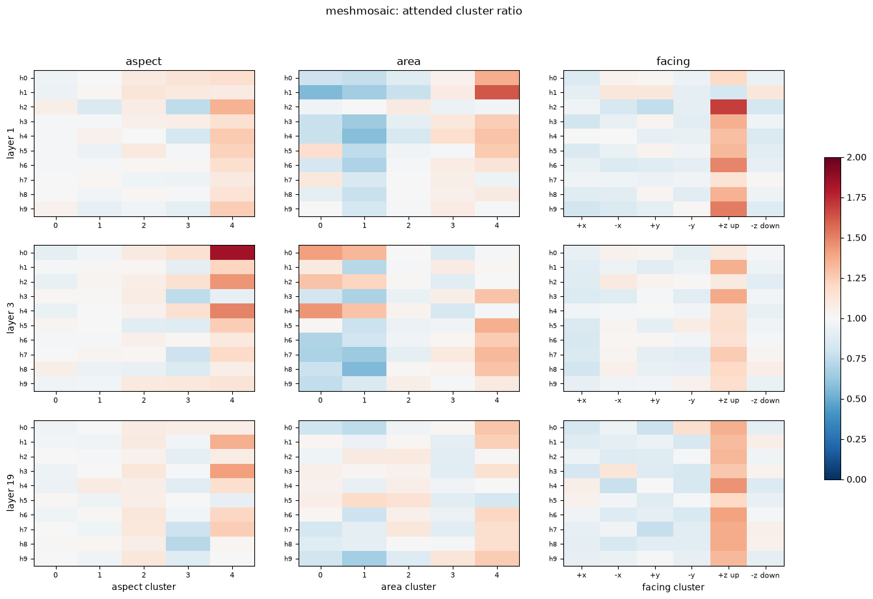
MeshMosaic Findings (WIP)
Head 2 strongly favors Triangles facing the z-axis orientation at Layer 1
Head 0 strongly favors Thin & Elongated Triangles at Layer 3
Attention Head Preferences
>1 means favor
1< means avoid

Slide 10
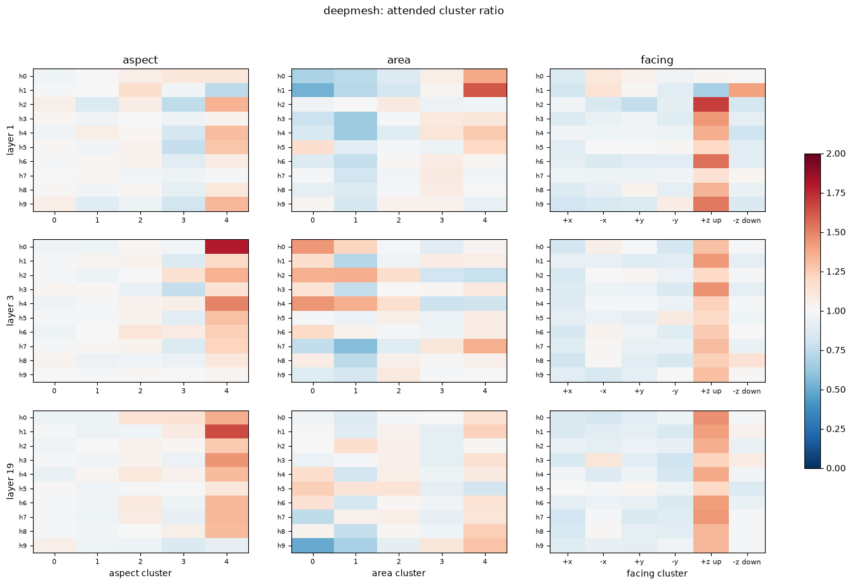
DeepMesh Findings (WIP)
Head 0 strongly favors Thin & Elongated Triangles at Layer 3
Attention Head Preferences
>1 means favor
1< means avoid
Head 1 strongly favors Thin & Elongated Triangles at Layer 19

Slide 11
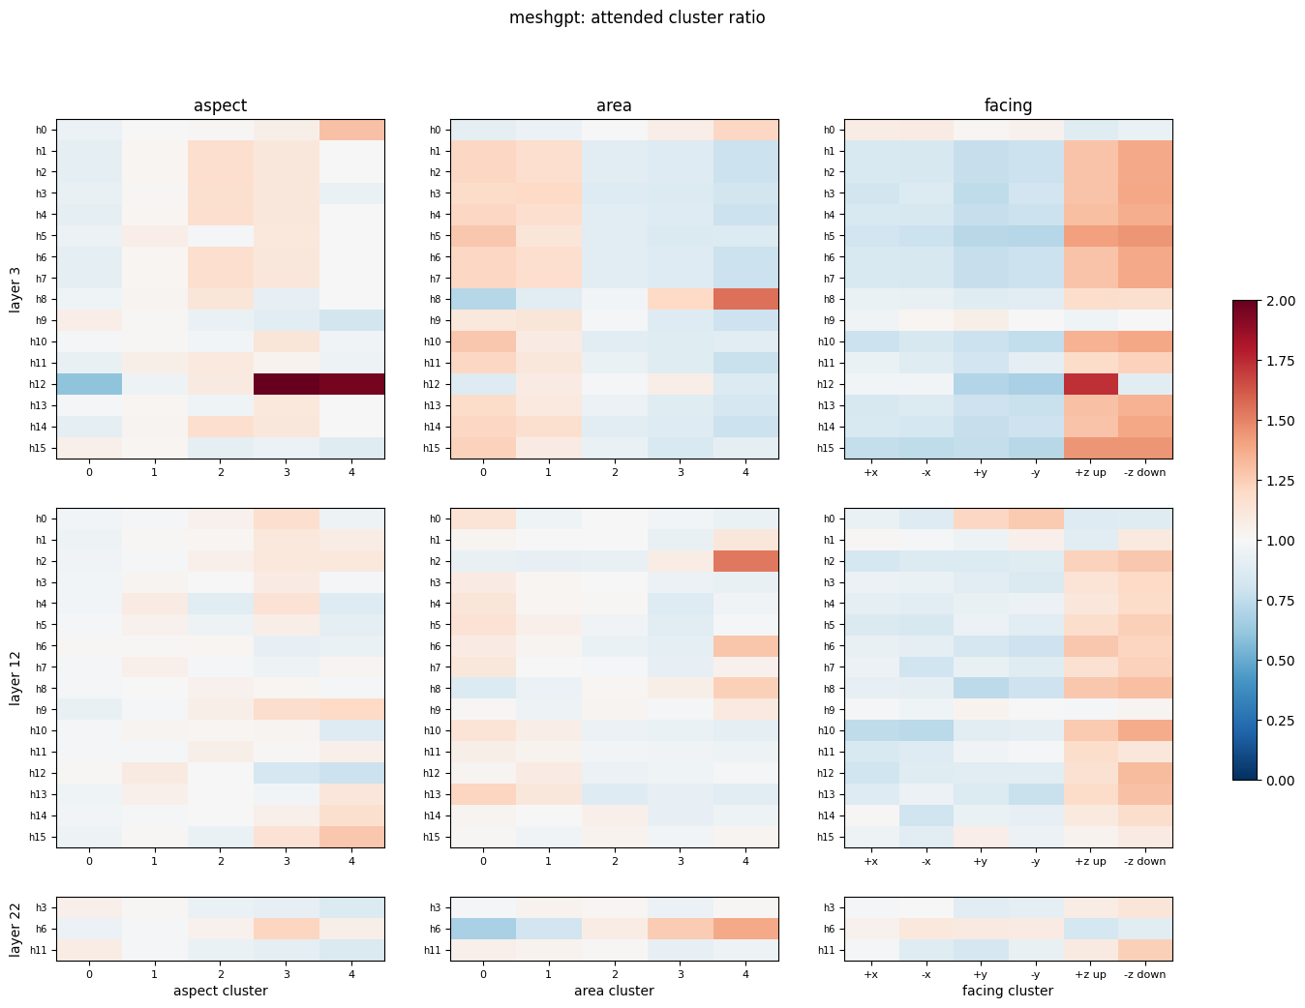
MeshGPT Findings(WIP)
Attention Head Preferences
>1 means favor
1< means avoid
Head 12 strongly favors Thin & Elongated Triangles at Layer 3

Slide 12
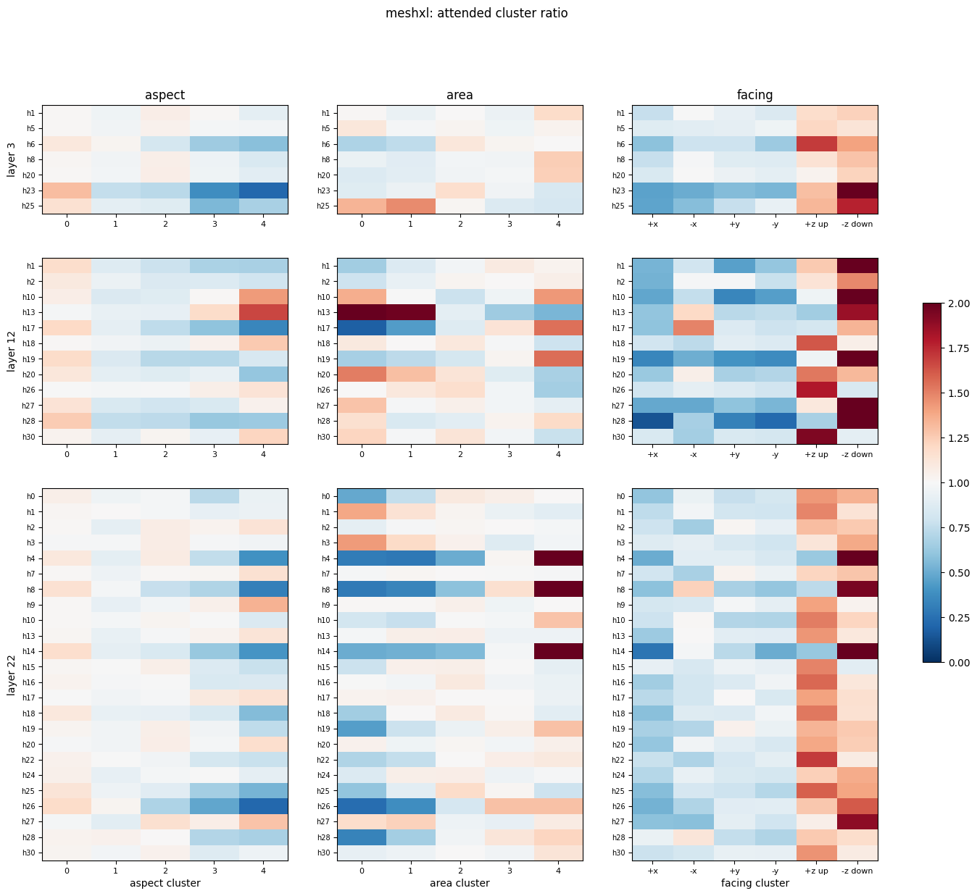
MeshXL Findings (WIP)
Varying facing orientation tendencies
Attention Head Preferences
>1 means favor
1< means avoid
Head 13 Smaller Area Triangles at Layer 12
Head 4, 8, 14 Larger Area Triangles at Layer 12

Slide 13
Extending the work
What’s next after this investigation? (Current Ideas)
Fine-tune 3D generators to generate artist quality mesh
  Amplify certain head behavior, injecting a prior/bias to certain heads to force them to produce consistent attention preference.
Hard-coding programmable rules on attention heads
  For heads that demonstrate consistent preference, hard-code their behavior into rules/policies to reduce computational expensiveness or potentially leading to better generation quality.
The why question
  Why does the model choose to attend to such features?
Challenges
  Retraining/fine-tuning can be computationally expensive
  Uncertainty about which methods would be beneficial

Slide 14
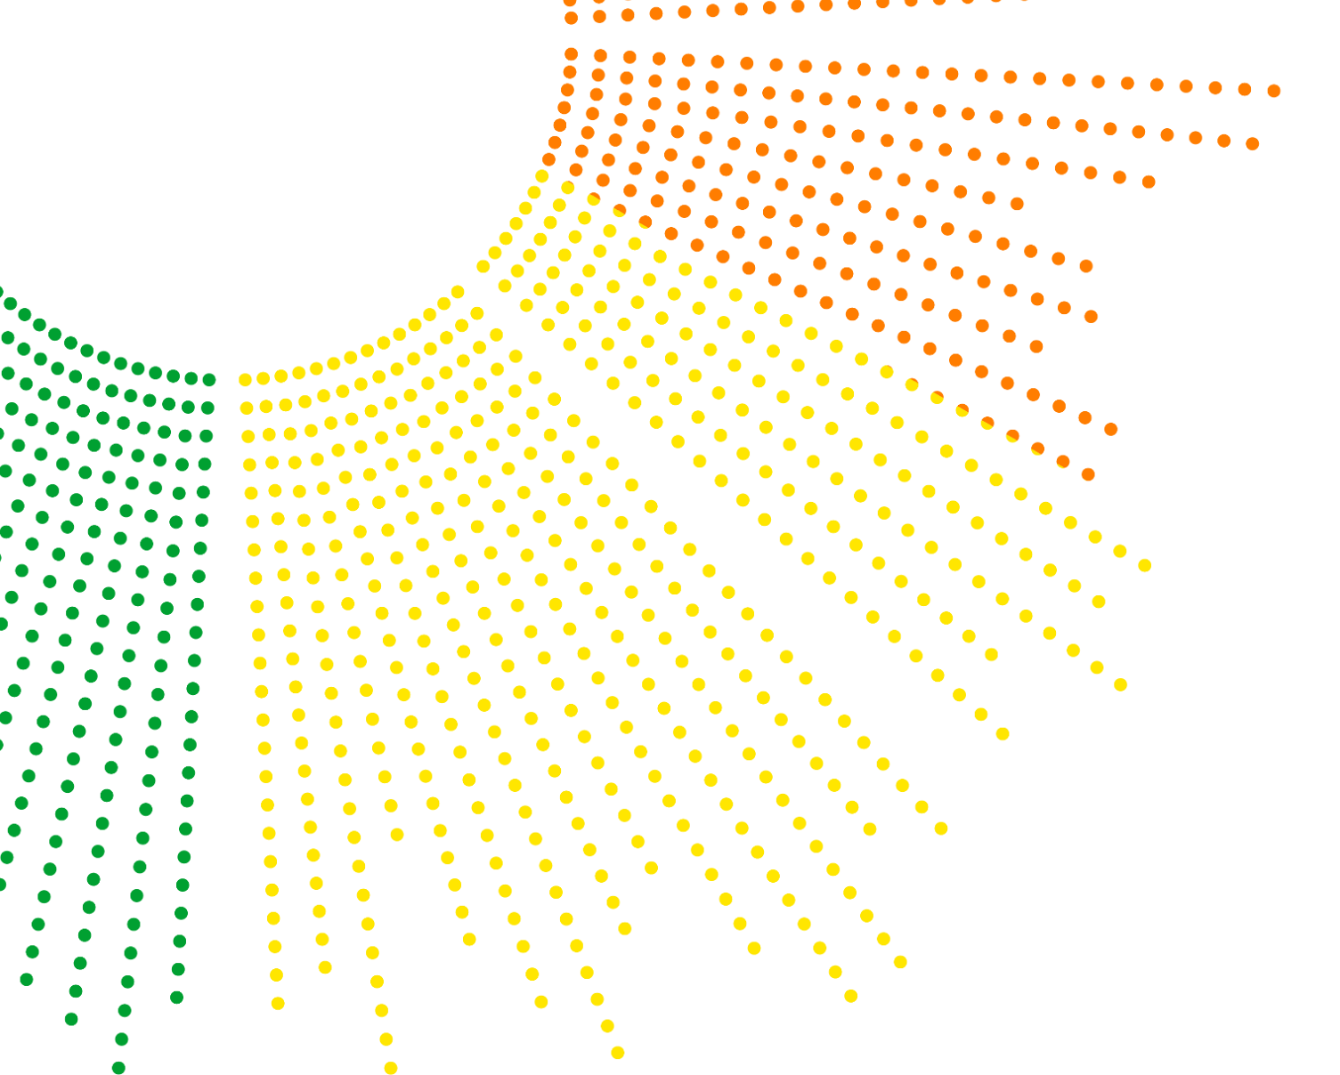



Contact Info & background
4th year UVA undergrad
B.S. in Data Science Major (ML concentration)
Pursuing Grad School Opportunities
Email: wkt7ne@virginia.edu

Slide 15
Thank you

